Slide 1
Chapter 3
Prescriptive Process Models
Generic process framework (revisited)
Traditional process models
Specialized process models
The unified process
(Source: Pressman, R. Software Engineering: A Practitioner’s Approach. McGraw-Hill, 2005)

Slide 2
Generic Process Framework
Communication
  Involves communication among the customer and other stake holders; encompasses requirements gathering
Planning
  Establishes a plan for software engineering work; addresses technical tasks, resources, work products, and work schedule
Modeling (Analyze, Design)
  Encompasses the creation of models to better under the requirements and the design
Construction (Code, Test)
  Combines code generation and testing to uncover errors
Deployment
  Involves delivery of software to the customer for evaluation and feedback

Slide 3
Modeling: Software Requirements Analysis
Helps software engineers to better understand the problem they will work to solve
Encompasses the set of tasks that lead to an understanding of what the business impact of the software will be, what the customer wants, and how end-users will interact with the software
Uses a combination of text and diagrams to depict requirements for data, function, and behavior
  Provides a relatively easy way to understand and review requirements for correctness, completeness and consistency

Slide 4
Modeling: Software Design
Brings together customer requirements, business needs, and technical considerations to form the “blueprint” for a product
Creates a model that that provides detail about software data structures, software architecture, interfaces, and components that are necessary to implement the system
Architectural design
  Represents the structure of data and program components that are required to build the software
  Considers the architectural style, the structure and properties of components that constitute the system, and interrelationships that occur among all architectural components
User Interface Design
  Creates an effective communication medium between a human and a computer
  Identifies interface objects and actions and then creates a screen layout that forms the basis for a user interface prototype
Component-level Design
  Defines the data structures, algorithms, interface characteristics, and communication mechanisms allocated to each software component

Slide 5
Traditional Process Models

Slide 6
Prescriptive Process Model
Defines a distinct set of activities, actions, tasks, milestones, and work products that are required to engineer high-quality software
The activities may be linear, incremental, or evolutionary
Prescriptive process models
1 Water fall
2 incremental process model
1 Incremental model
2 RAD model
3 Evolutionary process models
1Prototyping model
2 spiral model
3 Test Driven Development

Slide 7
Waterfall Model
(Diagram)
Communication
Project initiation
Requirements gathering
Planning
Estimating
Scheduling
Tracking
Modeling
Analysis
Design
Construction
Code
Test
Deployment
Delivery
Support
Feedback

Slide 8
Waterfall Model
(Description)
Oldest software lifecycle model and best understood by upper management
Used when requirements are well understood and risk is low
Work flow is in a linear (i.e., sequential) fashion
Used often with well-defined adaptations or enhancements to current software
Simple to implement
For small systems

Slide 9
Waterfall Model
(Problems)
Doesn't support iteration, so changes can cause confusion
Difficult for customers to state all requirements explicitly and up front
Requires customer patience because a working version of the program doesn't occur until the final phase
Problems can be somewhat alleviated in the model through the addition of feedback loops (see the next slide)

Slide 10
Waterfall Model with Feedback
(Diagram)
Communication
Project initiation
Requirements gathering
Planning
Estimating
Scheduling
Tracking
Modeling
Analysis
Design
Construction
Code
Test
Deployment
Delivery
Support
Feedback

Slide 11
Incremental Model
(Diagram)
Increment #1
Communication
Planning
Modeling
Construction
Deployment
Increment #2
Communication
Planning
Modeling
Construction
Deployment
Increment #3
Communication
Planning
Modeling
Construction
Deployment

Slide 12
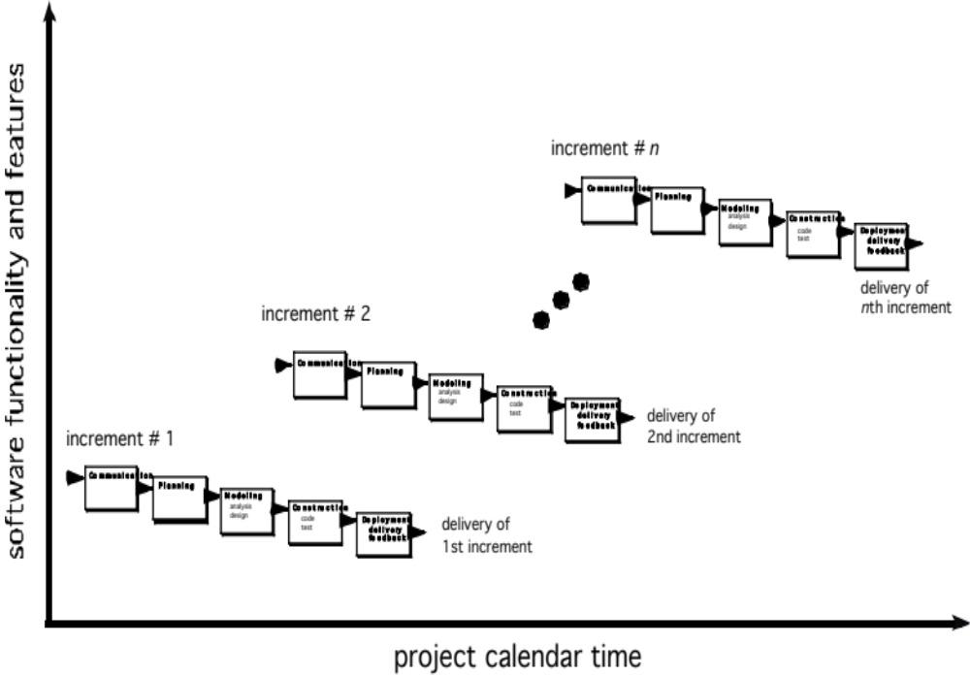

Slide 13
Incremental Model
(Description)
Used when requirements are well understood
Multiple independent deliveries are identified
Work flow is in a linear (i.e., sequential) fashion within an increment and is staggered between increments
Iterative in nature; focuses on an operational product with each increment
Provides a needed set of functionality sooner while delivering optional components later
Useful also when staffing is too short for a full-scale development

Slide 14
Prototyping Model
(Diagram)
Quick Planning
Communication
Start
Modeling
Quick Design
Deployment,
Delivery,
and Feedback
Construction
Of Prototype

Slide 15
Prototyping Model
(Description)
Follows an evolutionary and iterative approach
Used when requirements are not well understood
Serves as a mechanism for identifying software requirements
Focuses on those aspects of the software that are visible to the customer/user
Feedback is used to refine the prototype

Slide 16
Prototyping Model
(Potential Problems)
The customer sees a "working version" of the software, wants to stop all development and then buy the prototype after a "few fixes" are made
Developers often make implementation compromises to get the software running quickly (e.g., language choice, user interface, operating system choice, inefficient algorithms)
Lesson learned
  Define the rules up front on the final disposition of the prototype before it is built
  In most circumstances, plan to discard the prototype and engineer the actual production software with a goal toward quality

Slide 17
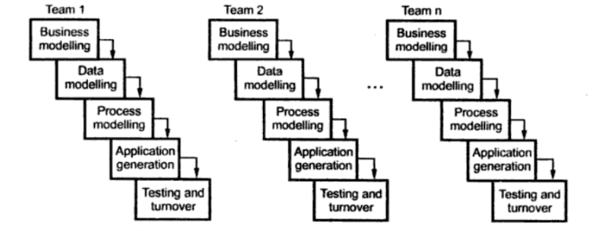
RAD Model(60-90 days)
cvvccf

Slide 18
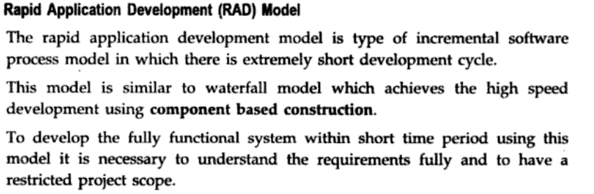

Slide 19
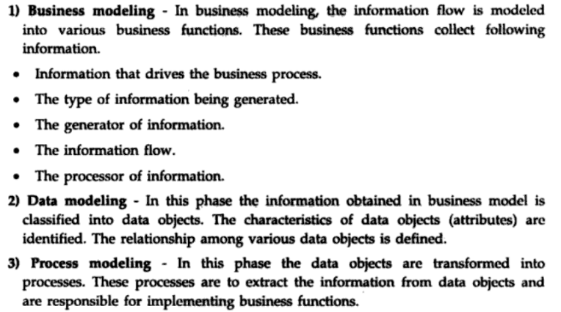

Slide 20
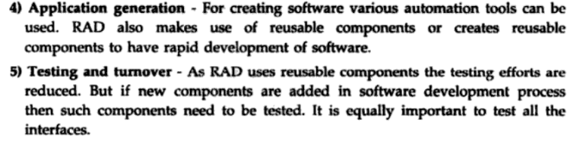

Slide 21
disadvantages
Multiple teams
Heavily committed devlepor
Heavy resources
Appropriate modularization else failing of project
Difficult to adopt new technology

Slide 22
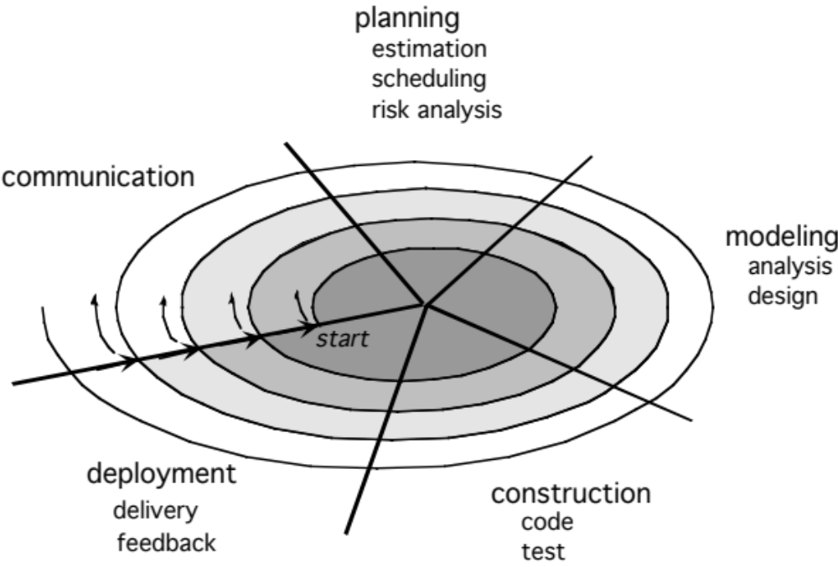
Spiral Model
(Diagram)
Planning
Communication
Start
Modeling
Start
Deployment
Construction

Slide 23
Spiral Model
(Description)
Invented by Dr. Barry Boehm in 1988 while working at TRW
Follows an evolutionary approach
Used when requirements are not well understood and risks are high
Inner spirals focus on identifying software requirements and project risks; may also incorporate prototyping
Outer spirals take on a classical waterfall approach after requirements have been defined, but permit iterative growth of the software
Operates as a risk-driven model…a go/no-go decision occurs after each complete spiral in order to react to risk determinations
Requires considerable expertise in risk assessment
Serves as a realistic model for large-scale software development

Slide 24
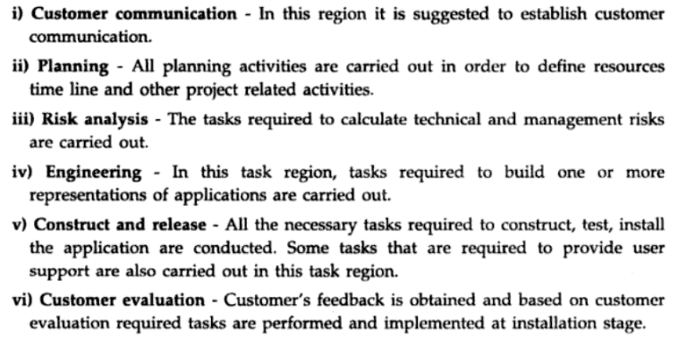

Slide 25
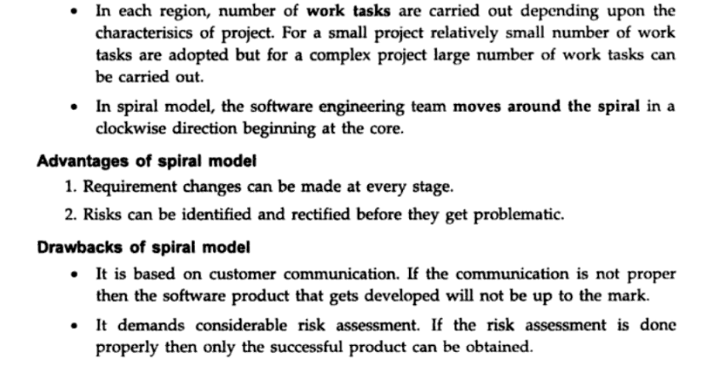

Slide 26

Test driven development

Slide 27
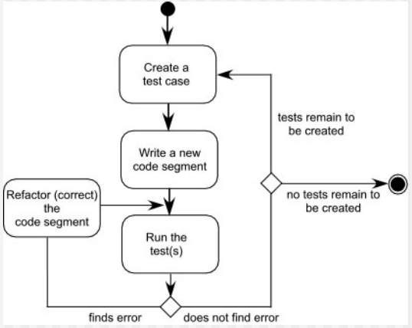

Slide 30
General Weaknesses of Evolutionary Process Models
Prototyping poses a problem to project planning because of the uncertain number of iterations required to construct the product
Evolutionary software processes do not establish the maximum speed of the evolution
  If too fast, the process will fall into chaos
  If too slow, productivity could be affected
Software processes should focus first on flexibility and extensibility, and second on high quality
  We should prioritize the speed of the development over zero defects
  Extending the development in order to reach higher quality could result in late delivery

Slide 31
Specialized Process Models

Slide 32
Component-based Development Model
Consists of the following process steps
  Available component-based products are researched and evaluated for the application domain in question
  Component integration issues are considered
  A software architecture is designed to accommodate the components
  Components are integrated into the architecture
  Comprehensive testing is conducted to ensure proper functionality
Relies on a robust component library
Capitalizes on software reuse, which leads to documented savings in project cost and time

Slide 33
Formal Methods Model
(Description)
Encompasses a set of activities that leads to formal mathematical specification of computer software
Enables a software engineer to specify, develop, and verify a computer-based system by applying a rigorous, mathematical notation
Ambiguity, incompleteness, and inconsistency can be discovered and corrected more easily through mathematical analysis
Offers the promise of defect-free software
Used often when building safety-critical systems

Slide 34
Formal Methods Model
(Challenges)
Development of formal methods is currently quite time-consuming and expensive
Because few software developers have the necessary background to apply formal methods, extensive training is required
It is difficult to use the models as a communication mechanism for technically unsophisticated customers

Slide 35
The Unified Process

Slide 36
Background
Birthed during the late 1980's and early 1990s when object-oriented languages were gaining wide-spread use
Many object-oriented analysis and design methods were proposed; three top authors were Grady Booch, Ivar Jacobson, and James Rumbaugh
They eventually worked together on a unified method, called the Unified Modeling Language (UML)
  UML is a robust notation for the modeling and development of object-oriented systems
  UML became an industry standard in 1997
  However, UML does not provide the process framework, only the necessary technology for object-oriented development

Slide 37
Background (continued)
Booch, Jacobson, and Rumbaugh later developed the unified process, which is a framework for object-oriented software engineering using UML
  Draws on the best features and characteristics of conventional software process models
  Emphasizes the important role of software architecture
  Consists of a process flow that is iterative and incremental, thereby providing an evolutionary feel
Consists of five phases: inception, elaboration, construction, transition, and production

Slide 38
Phases of the Unified Process
Inception
Elaboration
planning
modeling
communication
construction
Construction
deployment
Production
Transition

Slide 39
Inception Phase
Encompasses both customer communication and planning activities of the generic process
Business requirements for the software are identified
A rough architecture for the system is proposed
A plan is created for an incremental, iterative development
Fundamental business requirements are described through preliminary use cases
  A use case describes a sequence of actions that are performed by a user

Slide 40
Elaboration Phase
Encompasses both the planning and modeling activities of the generic process
Refines and expands the preliminary use cases
Expands the architectural representation to include five views
  Use-case model
  Analysis model
  Design model
  Implementation model
  Deployment model
Often results in an executable architectural baseline that represents a first cut executable system
The baseline demonstrates the viability of the architecture but does not provide all features and functions required to use the system

Slide 41
Construction Phase
Encompasses the construction activity of the generic process
Uses the architectural model from the elaboration phase as input
Develops or acquires the software components that make each use-case operational
Analysis and design models from the previous phase are completed to reflect the final version of the increment
Use cases are used to derive a set of acceptance tests that are executed prior to the next phase

Slide 42
Transition Phase
Encompasses the last part of the construction activity and the first part of the deployment activity of the generic process
Software is given to end users for beta testing and user feedback reports on defects and necessary changes
The software teams create necessary support documentation (user manuals, trouble-shooting guides, installation procedures)
At the conclusion of this phase, the software increment becomes a usable software release

Slide 43
Production Phase
Encompasses the last part of the deployment activity of the generic process
On-going use of the software is monitored
Support for the operating environment (infrastructure) is provided
Defect reports and requests for changes are submitted and evaluated

Slide 44
Unified Process Work Products
Work products are produced in each of the first four phases of the unified process
In this course, we will concentrate on the analysis model and the design model work products
Analysis model includes
  Scenario-based model, class-based model, and behavioral model
Design model includes
  Component-level design, interface design, architectural design, and data/class design
☺

